Slide 1
Introduction to Technical Specification TS1170.5: Part 2
Ken Elwood
MBIE/EQC Chief Engineer (Building Resilience)
University of Auckland

Slide 2
Technical Specification (TS) 1170.5
NSHM released Oct 2022.
Seismic Risk Working Group (SRWG) developed a draft of potential changes to NZS1170.5 to account for the results of the new NSHM.
Standards NZ convened a committee to convert this draft into a “Technical Specification”.
Now it’s your turn…
https://consultations.standards.govt.nz/draft-standards/ts1170-5-public-consultation/

Slide 3
Summary of Changes in Draft TS 1170.5
Section 1.4: Special Studies
Section 2: Verification
  Include consideration of geotechnical performance
Section 3.1: Horizontal Elastic Spectra
  Table of Hazard Values, Shape of spectrum, Site Classification, Active faults
Section 3.2: Vertical Elastic Spectra
Section 3.3: Parameters for Geotechnical Assessment and Design
Section 4.5.3 etc: Ratcheting provisions (removed)
Section 5.2: k_{μ} = μ
Section 5.9.1+6.6: Rocking foundations
Section 8: Parts and Components
Part 1:
Tuesday
Part 2:
Today

Slide 4
Presentations
Geotechnical Considerations – Rick Wentz
Rocking Foundations – John Hare
Parts and Components – John Hare
Demo of SESOC webtool to extract data from Tables 3.3 and 3.4 – Anne Hulsey
Q&A

Slide 5
Geotechnical Considerations - Key Takeaways
The performance of the foundation soils should be considered as part of the design verification process.
TS requires engineer to ensure foundation response does not compromise the assumed behaviour of the structure.
Commentary provided on several relevant geotechnical issues; more to come in Stage 2.

Slide 6
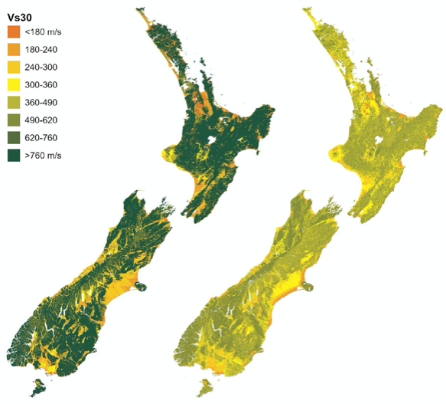
NATIONAL Vs30 MAPS
NOT TO BE USED FOR SITE-SPECIFIC DESIGN
Perrin et al. (2015) Foster et al. (2021)

Slide 7
Rocking Foundations – Key Takeaways
Many buildings experience modest rocking foundations during earthquakes; this can limit force demands but increase displacements.
TS allows simple structures meeting specific criteria to take advantage of this mechanism, without extensive effort.
Validation demonstrated that proposed simplified procedure was conservative, but provides relief for simple structures.

Slide 8
Parts and Components – Key Takeaways
TS recognises that a small amount of effective ductility (e.g. bolt slip) provides a significant reduction in the actions on the part when near resonance.
Recommend using effective ductility values in Table C8.2
Non-linear response of the supporting structure will limit peak floor accelerations, also limiting demand on parts. ​

Slide 9
SESOC Webtool for TS 1170.5
Demo by Anne Hulsey

Slide 10
Q&A

Slide 11
Where to from here?
Draft TS 1170.5 provided to SNZ
Earliest possible citing of TS1170.5 in B1/VM1
Release TS 1170.5?
NSHM Released
Public Comment for TS 1170.5
Test drive TS1170.5
2022
2023
2024
2025
2026
SRWG Stage 2

Slide 12
SRWG Stage 2
Challenges with current system to be addressed in Stage 2:
  Current design philosophy has led to buildings which will experience damage a low levels of shaking.
  Current compliance framework does not adequately address geotechnical considerations.
  NZS1170.5:2004 does not require capacity design (of some form) for all buildings leading to uncertainty in the seismic performance of such structures.
  Current Importance Level system confuses amenity and life safety performance objectives.

Slide 13
Use of TS 1170.5 - Key Messages
Draft TS 1170.5 is only for public comment – not for design!
Once published:
  Use only via Alternative Solutions
    NZS 1170.5:2004 remains the cited standard in B1/VM1
    Feedback on experience with TS will inform any decision to cite TS 1170.5 in the future.
  Do not mix and match TS 1170.5 and NZS 1170.5:2004
    Use each in their entirety
  Continue to use NZS 1170.5:2004 for all seismic assessments
Please submit a public comment!
https://consultations.standards.govt.nz/draft-standards/ts1170-5-public-consultation/

Slide 14
Thank you for attending!

